Slide 1

Myers-Briggs Type Indicator
By Aomi Kosugi & Dylan Hayes

Slide 2
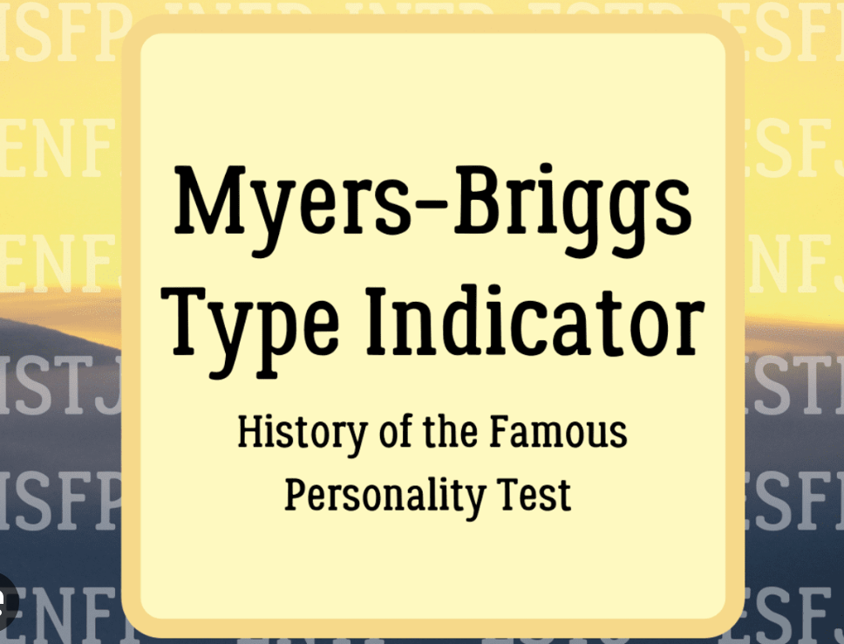
Introduction:
Our goal is to develop a machine learning model for personality prediction that is based on the Myers-Briggs Type Indicator, or MSTB.
Our study uses cutting-edge data science and machine learning approaches to analyse and forecast personality features.

Slide 3
Rationale behind our Project:
The MSTB, is a highly effective instrument utilised not only in the evaluation of prospective employees, but also in aiding individuals in the identification of their aptitudes and areas of exceptional performance.
This subject matter is of sincere interest to us, and we hold the belief that it have the capacity to provide a beneficial influence.
By utilising MSTB data, it is possible to provide individuals with valuable insights that can aid them in making well-informed choices regarding their career trajectories and personal growth.

Slide 4

SDG’s Relevance:
The inquiry may arise as to how our project corresponds with the Sustainable Development Goals (SDGs) established by the United Nations.
Although we remain receptive to recommendations, we contend that our project makes a significant contribution to both Sustainable Development Goal 8, which focuses on promoting decent work and fostering economic growth, as well as Sustainable Development Goal 9, which emphasises the importance of industry, innovation, and infrastructure.
Our research endeavours align with these objectives by facilitating the cultivation of skills and offering useful perspectives on individual strengths and employment prospects. By facilitating the identification of individuals' optimal career trajectories, we contribute to the advancement of economic growth and the fostering of innovation.

Slide 5

Data Gathering Process
Well, after conducting thorough research, we've decided to source our data from Kaggle, a well-known platform for datasets. Kaggle provides a wealth of data resources, including datasets related to personality traits, which will serve as the foundation for our predictive model."

Slide 6

Types of Data we need:
We need a specific kind of data for our project—datasets containing information about personality traits. This data will be vital for training our machine learning model.
Personality traits, such as extroversion, openness, and conscientiousness, will enable us to make accurate predictions and provide valuable insights

Slide 7

Algorithm Being Used:
Our choice of algorithm for this project is Linear Regression. This algorithm is well-suited for our task because it allows us to model the relationship between personality traits and various outcomes. Linear regression is a reliable and interpretable choice that will help us build a predictive model based on the personality traits we've gathered.

Slide 8

What Area of Ethical OS 8 Risk Zones Does Our Project Fit Into?
In relation to the Ethical OS 8 Risk Zones, we are receptive to recommendations, and one notable consideration is the aspect of 'Privacy.' Our project is in accordance with this Risk Zone since we recognise the significance of protecting personal data, particularly when handling sensitive personality features. Our organisation is dedicated to the implementation of comprehensive privacy protocols in order to safeguard the confidentiality and security of the data we acquire and gather.

